Slide 1

Assembly Language
Part VIII Addressing Modes
Department of Computer Science, Faculty of Science, Chiang Mai University

Slide 2
Outline
One-Dimensional Arrays
Addressing Modes
Two-Dimensional Arrays
Based Indexed Addressing Mode

Slide 3
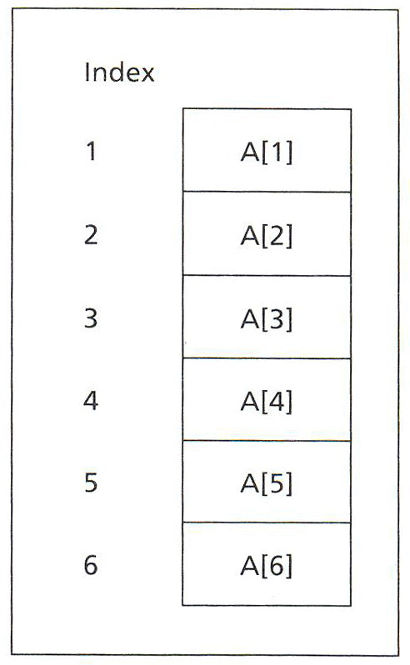
One-Dimensional Array A

Slide 4
The DUP Operator
The DUP (duplicate) is used to define arrays whose elements share a common initial value.
repeat_count DUP (value)
GAMMA DW 100 DUP (0)
DELTA DB 212 DUP (?)
LINE DB 5, 4, 3 DUP (2, 3 DUP (0), 1)
LINE DB 5,4,2,0,0,0,1,2,0,0,0,1,2,0,0,0,1

Slide 5
One-Dimensional Array A
W DW 10, 20, 30, 40, 50, 60
Offset address Symbolic address Decimal address
0200h W 10
0202h W + 2h 20
0204h W + 4h 30
0206h W + 6h 40
0208h W + 8h 50
020Ah W + Ah 60

Slide 6
Addressing Modes
The way an operand is specified
register mode: an operand is a register.
immediate mode: an operand is a constant.
direct mode: an operand is a variable.
MOV AX, 0
ADD ALPHA, AX

Slide 7
Register Indirect Mode
[register]
The register is BX, SI, DI, or BP.
For BX, SI, or DI, the operand’s segment number is contained in DS.
For BP, SS has the segment number.

Slide 8
Suppose that SI contains 0100h, and the word at 0100h contains 1234h.
MOV AX, [SI] ; AX = 1234h
The CPU
examines SI and obtains the offset address 100h,
uses the address DS:0100h to obtain the value 1234h, and
moves 1234h to AX.
MOV AX, SI ; AX = 0100h

Slide 9
Suppose that
BX contains 1000h Offset 1000h contains 1BACh
SI contains 2000h Offset 2000h contains 20FEh
DI contains 3000h Offset 3000h contains 031Dh
where the above offsets are in the data segment addressed by DS.

Slide 10
Tell which of the following instructions are legal. If legal, give the source offset address and the result or number moved.
Source offset Result
MOV BX, [BX] 1000h 1BACh
MOV CX, [SI] 2000h 20FEh
MOV BX, [AX] illegal source register
ADD [SI], [DI] illegal memory-memory addition
INC [DI] 3000h 031Eh

Slide 11
Write some code to sum in AX the elements of the 10-element array W defined by
W DW 10,20,30,40,50,60,70,80,90,100

Slide 12
The idea is to set a pointer to the base of the array, and let it move up the array, summing elements as it goes.
XOR AX, AX ; AX holds sum
LEA SI, W ; SI points to array W
MOV CX, 10 ; CX has number of elements
ADDNOS:
ADD AX, [SI] ; sum = sum + element
ADD SI, 2 ; move pointer to
; the next element
LOOP ADDNOS ; loop until done

Slide 13
Based and Indexed Addressing Mode
[register + displacement]
[displacement + register]
[register] + displacement
displacement + [register]
displacement[register]
based: BX(base register) or BP (base pointer)
indexed: SI (source index) or DI (destination index)

Slide 14
Based and Indexed Addressing Mode
MOV AX, W[BX]
MOV AX, [W + BX]
MOV AX, [BX + W]
MOV AX, W + [BX]
MOV AX, [BX] + W

Slide 15
Rework the last example by using based mode.
XOR AX, AX ; AX holds sum
XOR BX, BX ; clear base register
MOV CX, 10 ; CX has number of elements
ADDNOS:
ADD AX, W[BX] ; sum = sum + element
ADD BX, 2 ; index next element
LOOP ADDNOS ; loop until done

Slide 16
Suppose that ALPHA is declared as
ALPHA DW 0123H, 0456h, 0789h, 0ABCDh
in the segment addressed by DS.
Suppose also that
BX contains 2 Offset 0002 contains 1084h
SI contains 4 Offset 0004 contains 2BACh
DI contains 1

Slide 17
Tell which of the following instructions are legal. If legal, give the source offset address and the result or number moved.
Source offset Number moved
MOV AX, [ALPHA+BX] ALPHA+2 0456h
MOV BX, [BX+2] 2+2 = 4 2BACh
MOV CX, ALPHA[SI] ALPHA+4 0789h
MOV AX, –2[SI] –2+4 = 2 1084h
MOV BX, [ALPHA+3+DI] ALPHA+4 0789h
MOV AX, [BX] 2 Illegal form of source operand
ADD BX, [ALPHA+AX] Illegal source register

Slide 18
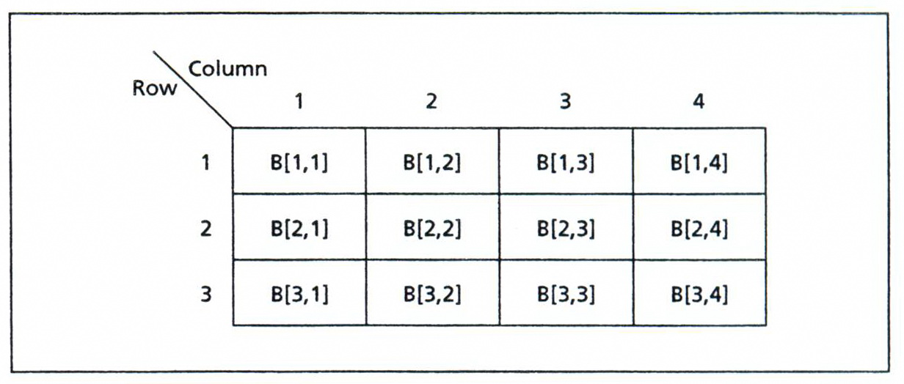
Two-Dimensional Array B

Slide 19
Row-Major Order
B DW 10, 20, 30, 40
DW 50, 60, 70, 80
DW 90, 100, 110, 120

Slide 20
Column-Major Order
B DW 10, 50, 90
DW 20, 60, 100
DW 30, 70, 110
DW 40, 80, 120

Slide 21
Based Indexed Addressing Mode
variable [base_register][index_register]
[base_register + index_register + variable + constant]
variable [base_register + index_register + constant]
constant [base_register + index_register + variable]

Slide 22
Based Indexed Addressing Mode
MOV AX, W[BX][SI]
MOV AX, [W + BX + SI]
MOV AX, W[BX + SI]

Slide 23
An application: Average Test Scores
sum[j] = 0
i = 1
FOR 5 times DO
sum[j] = sum[j] + score[i, j]
i = i + 1
END_FOR

Slide 24
Reference
Ytha Yu and Charles Marut, Assembly Language Programming and Organization of the IBM PC. New York: McGraw-Hill, 1992.

